Slide 1
3D Printing and Physics Simulation
Karol Kováč, supervisor Mgr. Jiří Chmelík, Ph.D.

Slide 2
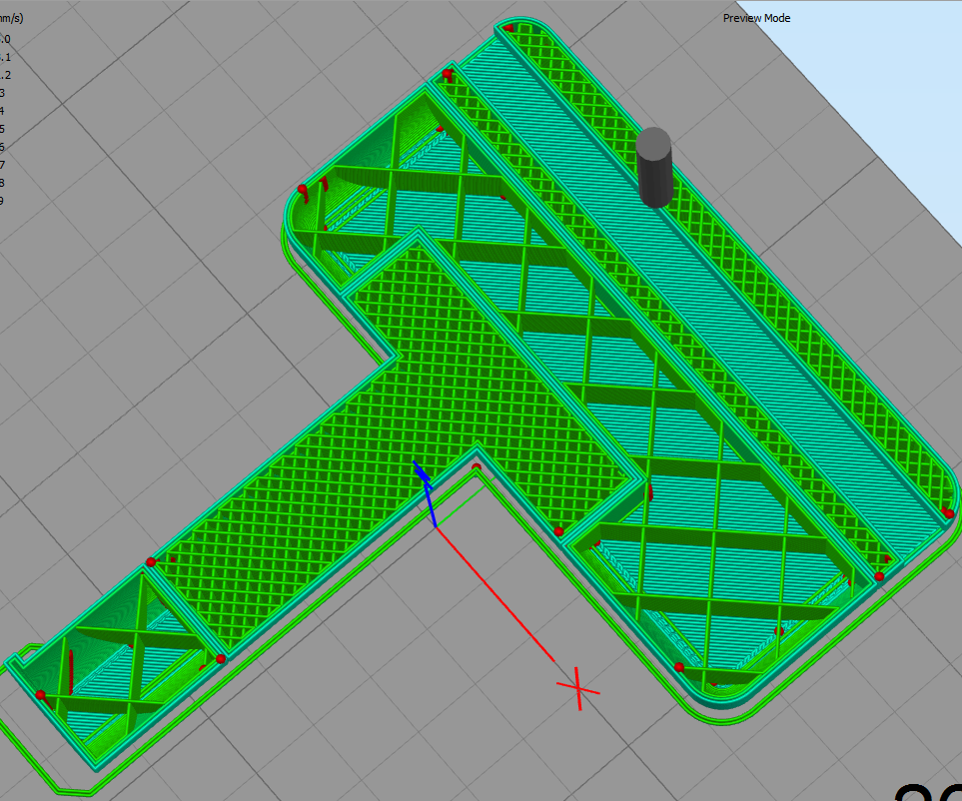
Local changes of infill densities
To strengthen fragile parts
Side efect →shifting CoM
Goal →use this feature to purposely shift CoM
https://content.instructables.com/ORIG/F1K/RNHW/IJQODA06/F1KRNHWIJQODA06.png?frame=1

Slide 3
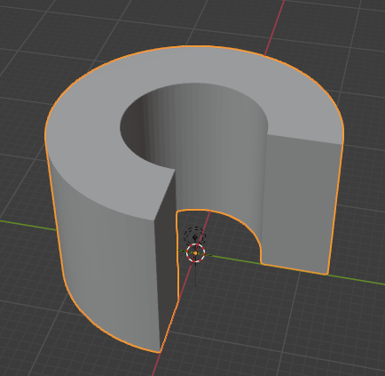
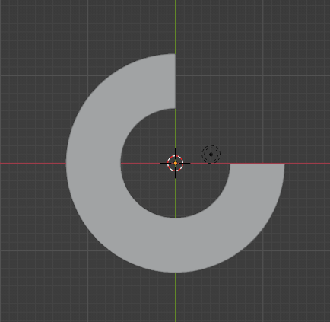
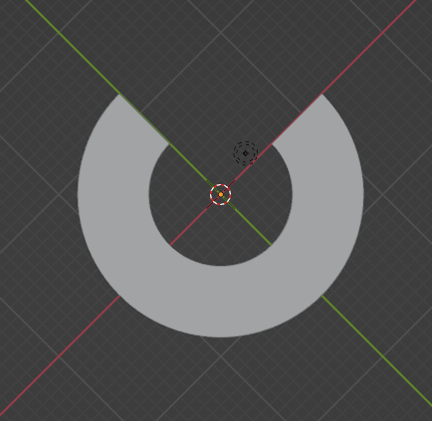
Example
GRAVITY

Slide 4
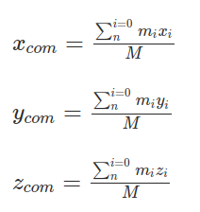
Computation (theoretical model)
Sum of masses on the left * their position has to be equal to sum of masses on the right * their position
Split model into patrs
For each part find
CoM
Volume
20%
20%
40%
m = v * ρ

Slide 5
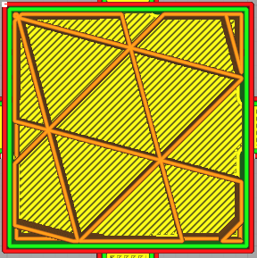
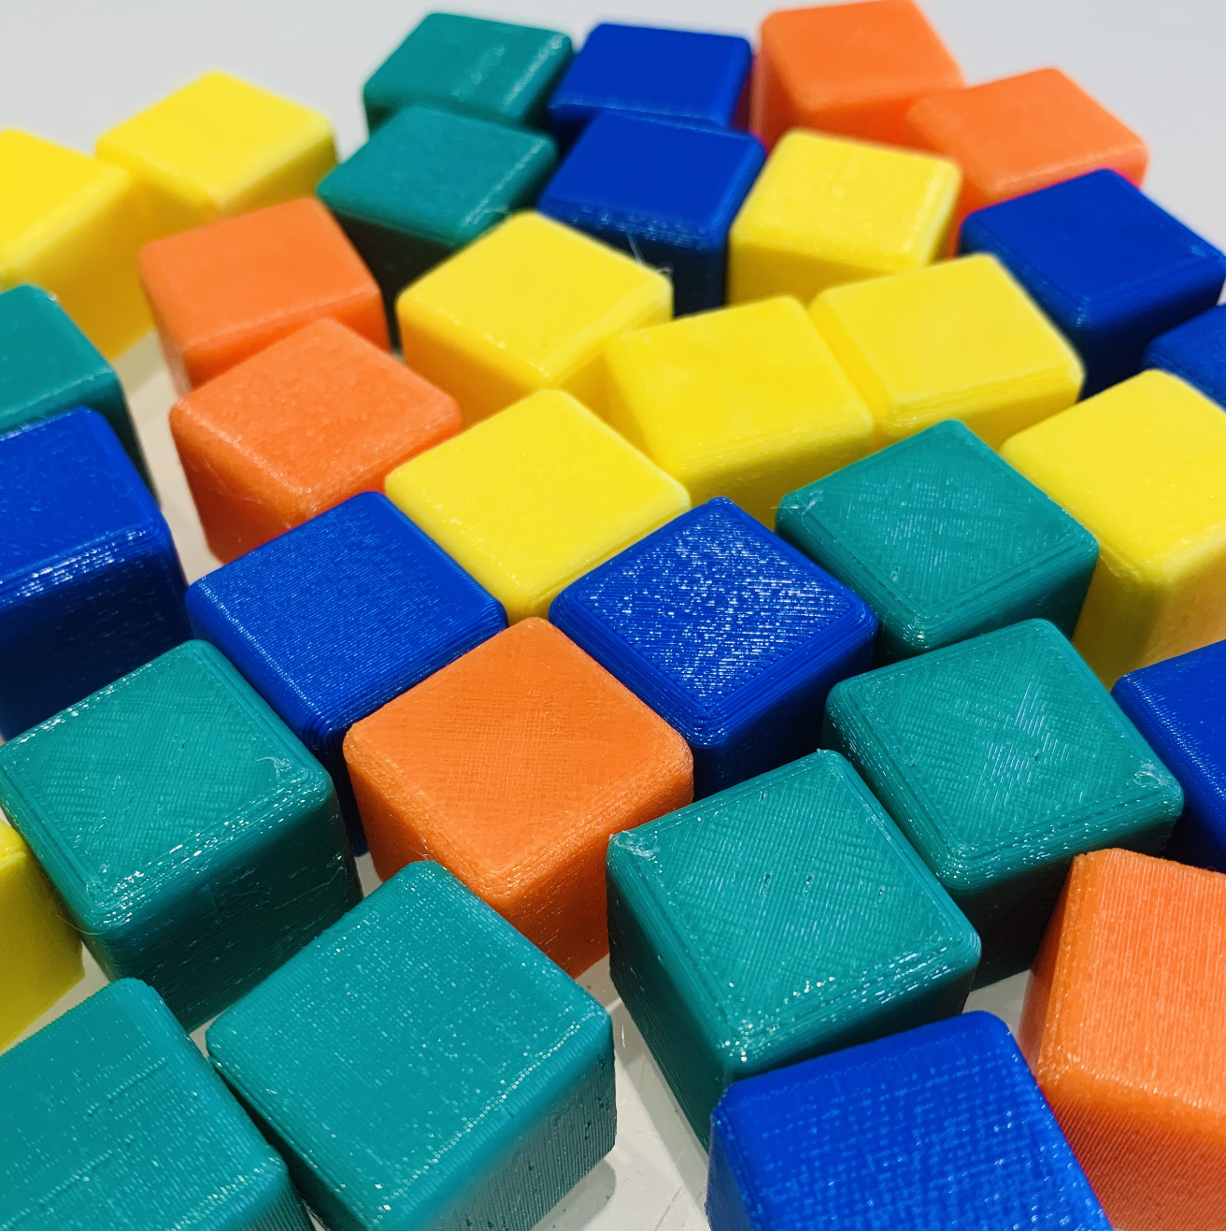
Expected deviations
15 %
?
=
?
=
Theoretical model
Sliced model
Printed model

Slide 6
CoM from GCode
For each “move” instruction (G0, G1):
Position (X.., Y.., Z..)
Total material extruded (E..)
For each stroke (extruded line):
CoM (X.., Y.., Z..)
Weight (amount of material extruded)
. . .
G1 X182.619 Y122.435 E6.35231
G1 X182.294 Y123.024 E6.36117
M204 S625
M205 X50 Y50
G0 F1285.7 X181.873 Y122.903
M205 X20 Y20
G1 F600 X181.482 Y123.42 E6.3697
G1 X181.03 Y123.884 E6.37823
G1 X180.525 Y124.289 E6.38676
. . .
(X10, Y4, Z1, E2.7)
CoM (7.5, 3, 1)
Weight = 0.3 * density
(X5, Y2, Z1, E2.4)

Slide 7
Future Future work attempt
Slice model with computed densities
User sets where
CoM should be
Program automatically computes densities
Compute CoM from GCode
OK
NOK
Adjust densities

Slide 8
Future Future work attempt
Slice model with computed densities
User sets where
CoM should be
Program automatically computes densities
Compute CoM from GCode
OK
Not trivial!
NOK
Adjust densities

Slide 9
Simplified version
Slice model with computed densities
Compute CoM from GCode
OK
User can interactively adjust densities and see the CoM
NOK
Adjust densities

Slide 10


Simplified version
Slice model with computed densities
Compute CoM from GCode
OK
User can interactively adjust densities and see the CoM
NOK
Adjust densities

Slide 11
Simplified version
Unable to change densities using CuraEngine CLI
Slice model with computed densities
Compute CoM from GCode
OK
User can interactively adjust densities and see the CoM
NOK
Adjust densities

Slide 12
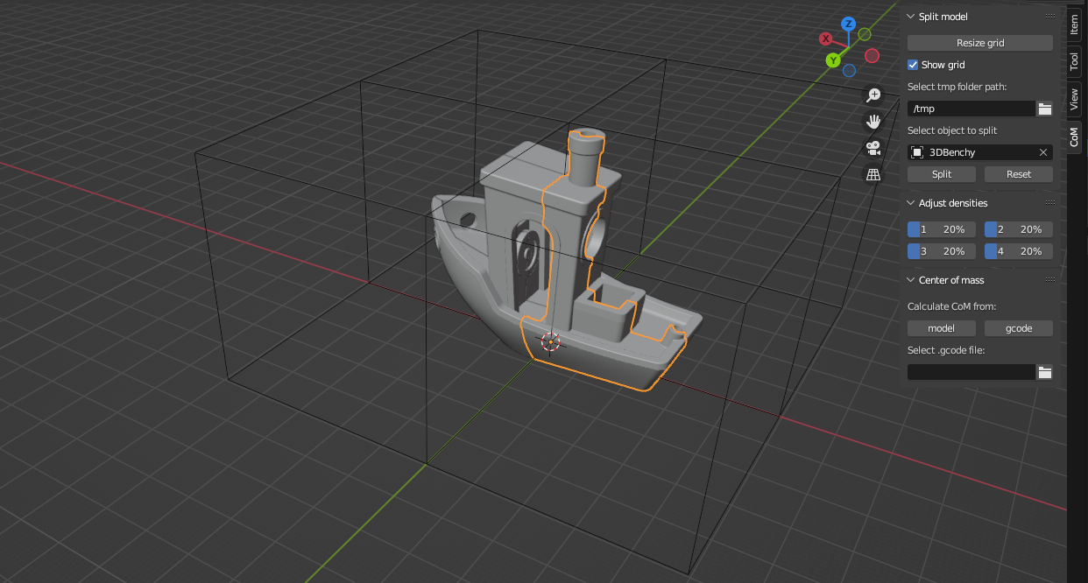
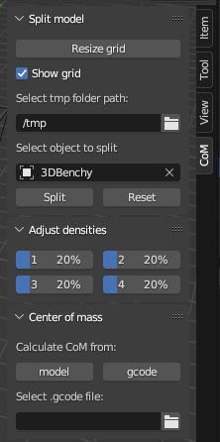
Results
Blender addon for CoM visualization (both theoretical model and from GCode)

Slide 13

Results

Slide 14
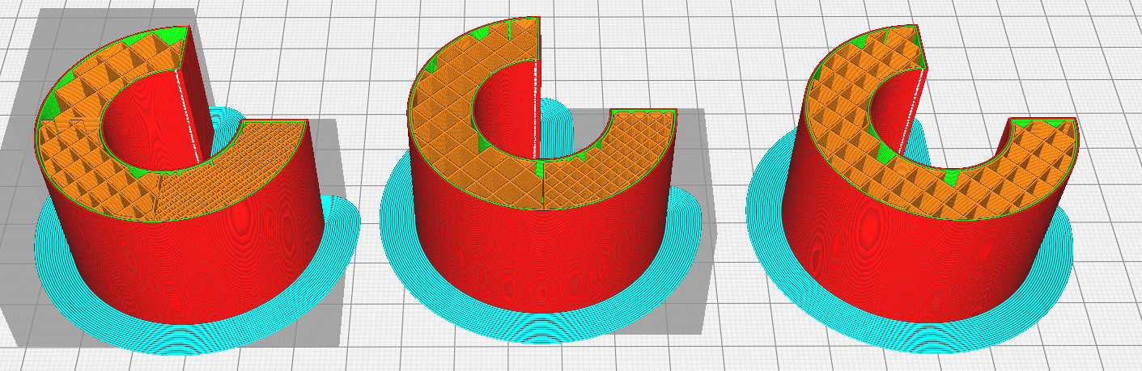
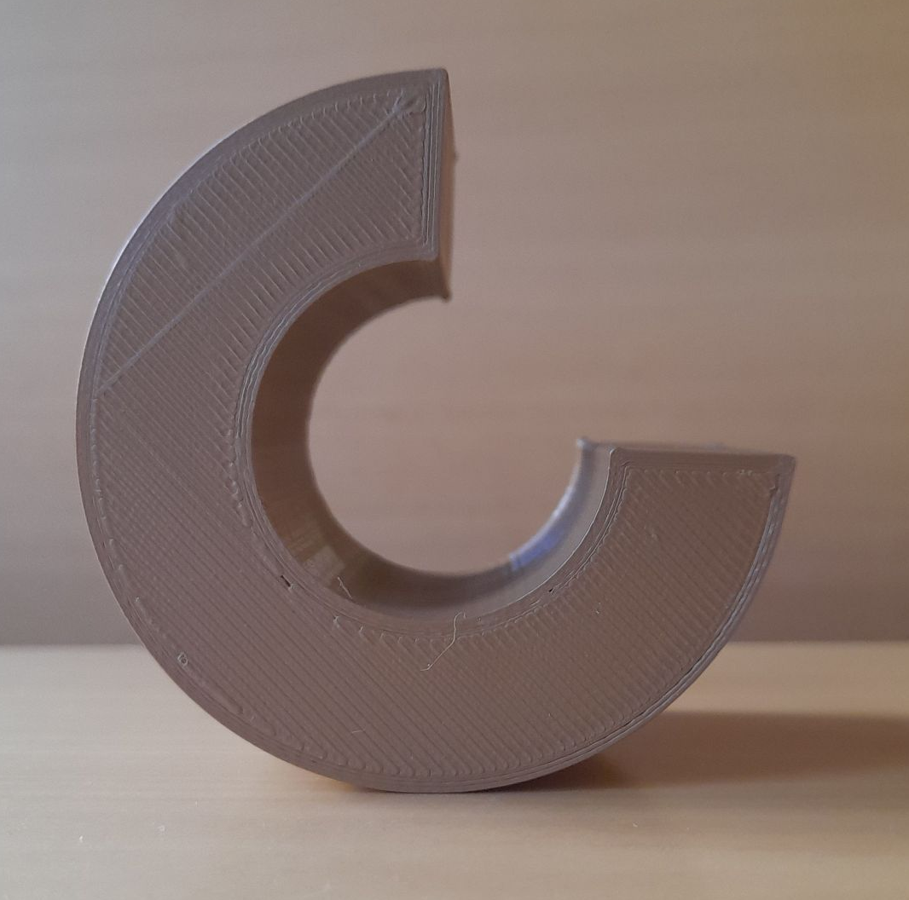
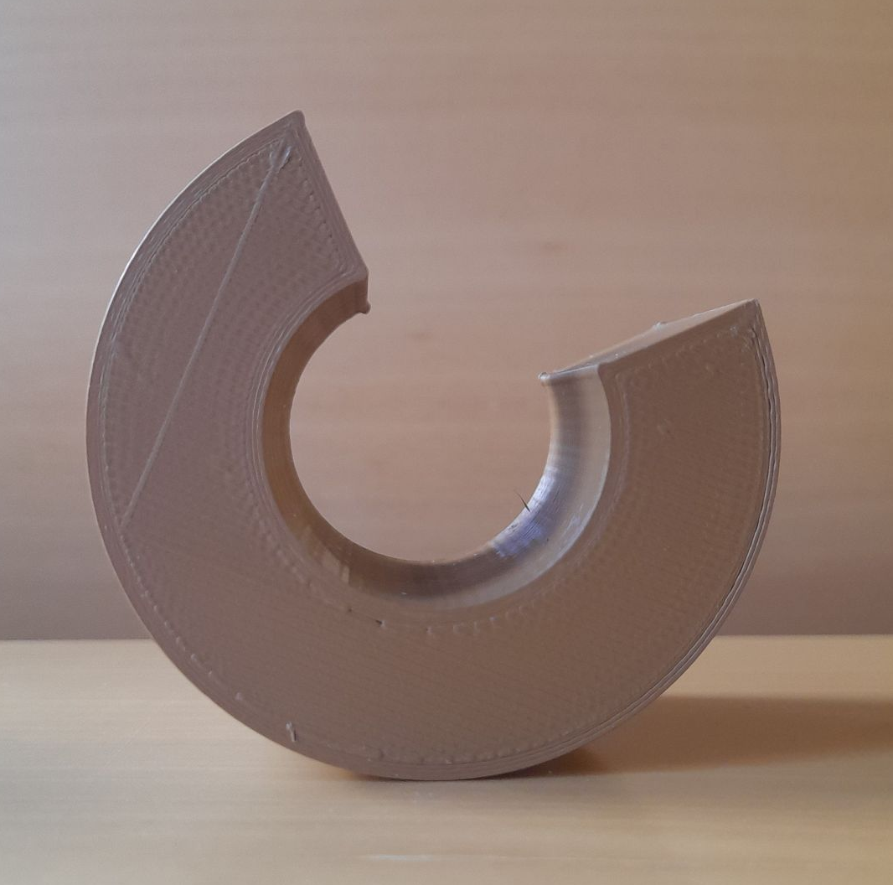
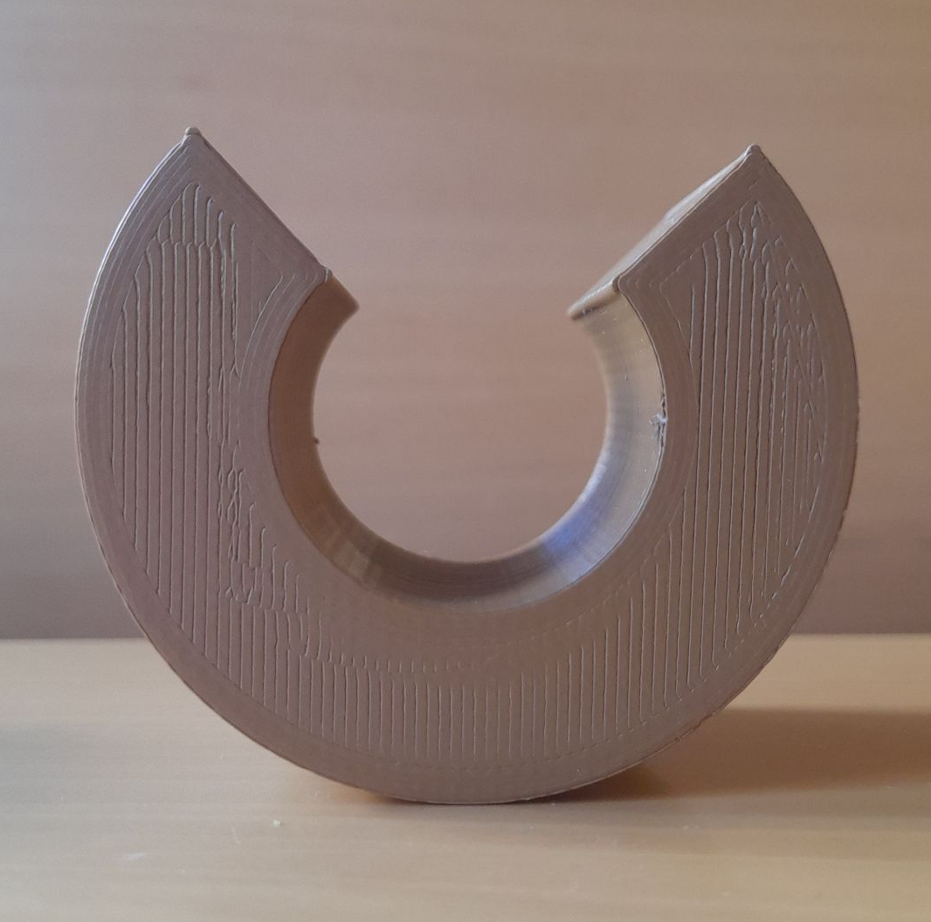
Test prints
15%
20%
22%
75%
20%
40%
20%
Based on GCode
Theoretical model
No modifications

Slide 15
What I learned
blender scripting
How gcode works
using numpy-stl library
using CureEngine from CL

